Slide 1
MEDICINAL
PLANTS
LUCIA KOCÚREKOVÁ II.A

Slide 2
There are a lot of plants in Presov region for example:
-protected
-medicated
-or just plain
There are also many protected areas for instance:
-National Nature Reserve Vihorlat
-National Nature Reserve Lysa
-National Nature Reserve Little Sea Eye
-etc...

Slide 3
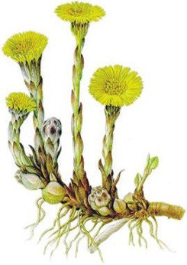
Tussilago
DESCRIPTION OF PLANT
Tussilago is perennial plant that blooms mostly as the first all of the medicinal plants
Stem grows to a height of 25 cm,it is covered with pink and purple scales
On top of the stem is large yellow flower
The leaves are long and they grow in rosette

Slide 4
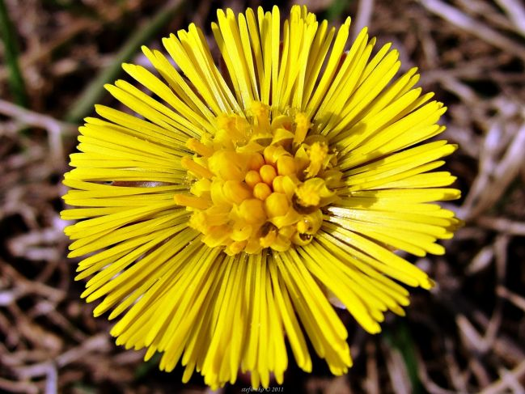
Habitat
It grows in wet soils, from
lowlands to the hills like a weed
They often grow in loamy soils,
waste ground, embankments
and in ditches
HARVEST
It blooms from March to April
The flowers are collected at the beginning of blooming, preferably between 14 and 16 hours
The flowers are torn by hand or cut with a short stem
Leaves are collected in May and June, preferably up to 9 hours in the morning
Flower must not be attacked by rust or pests

Slide 5
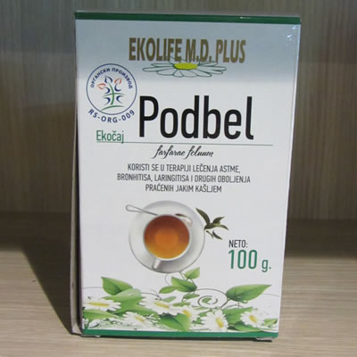
HEALING EFFECTS
Tussilago is very well known and currently used medicinal plant that is used internally and externally
It is part of several pharmaceutical preparation of tea
It is used especially in diseases of the airways,bronchi and the lungs, the digestive disorders, regulates drug metabolism, the hard healing wounds, eczema,
swelling, pain rheumatic place
and many others diseases

Slide 6
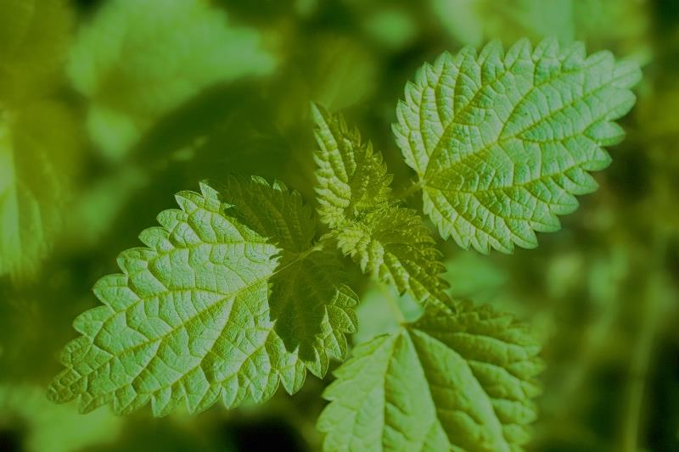
Urtica dioica
DESCRIPTION OF PLANT
This is very famous and extended 50 to 120 cm tall perennial herb, all covered with glandular nettle hairs
The flowers are small and green
HABITAT
It grows like weed from the lowlands to the foothills in ditches along roads and near the rivers, especially near human settlements
It likes wet soil with a high number of nitrogen

Slide 7
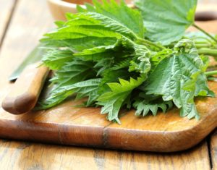
HARVEST
The young leaves are picked from May to September and even several times during the year. During harvest we must use gloves

Slide 8
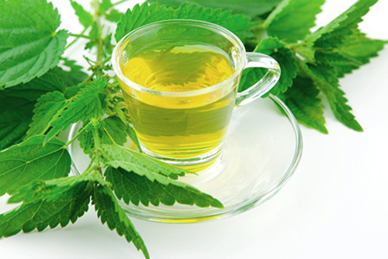
HEALING EFFECTS
Its medical use offers a wide range of possibilities
It also helps in disorders of the urinary tract, supports the treatment of diabetes, metabolism and the production of blood cells
Aboveground parts contain large amounts of vitamin C, which helps ensure good absorption of iron from the plant into the body
Therefore, a good tonic in cases of anemia
In cosmetics, the powerful mash tops Stinging Nettle is used for rinsing the hair, strengthens the scalp and removes dandruff. Hair thicken, become soft, shiny and have a good process

Slide 9
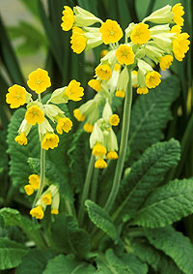
Primrose
DESCRIPTION OF PLANT
Primrose is a perennial herb with a bare stem
The leaves grow directly from the rhizome
The plant reaches a height about 30 cm
The flowers are large, yellow, arranged in umbels on top of the stem
The flowers smell only slightly
HABITAT
It blooms from April to June
Primrose grows in dry habitats, meadows, pastures, sunny hillsides, but also in sparse forests

Slide 10
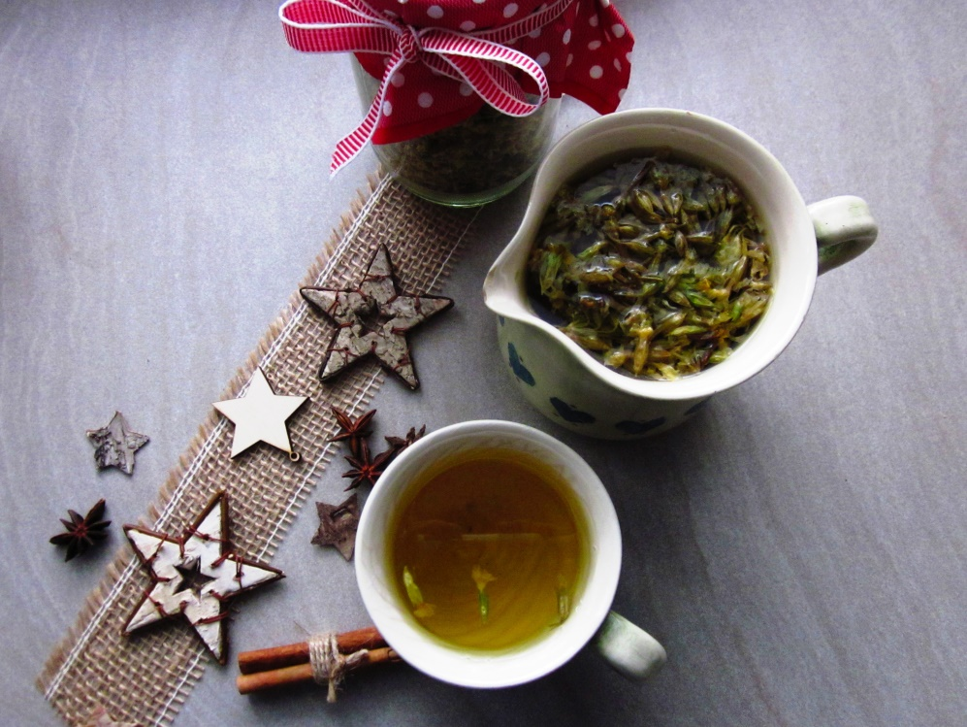
HARVEST
We pick only flower without stem during full blooming
From April to May
HEALING EFFECTS
It helps out the coughing a mucus.
The other good properties are calming effect, therefore, it is used as an ingredient in tea which ais against stress, neurosis, migraine and insomnia

Slide 11
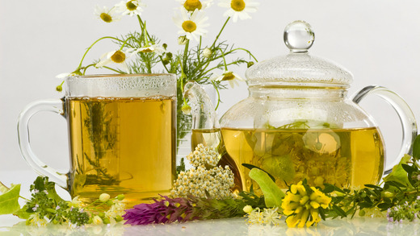
Lot of plants which grow around us are medicinal plants.
We should grasp it.

Slide 12
Thank for your attention.

